Slide 1
Thinking the unthinkable – doing away with the library catalogue
UKSG Webinar, June 2014
Simone Kortekaas

Slide 2
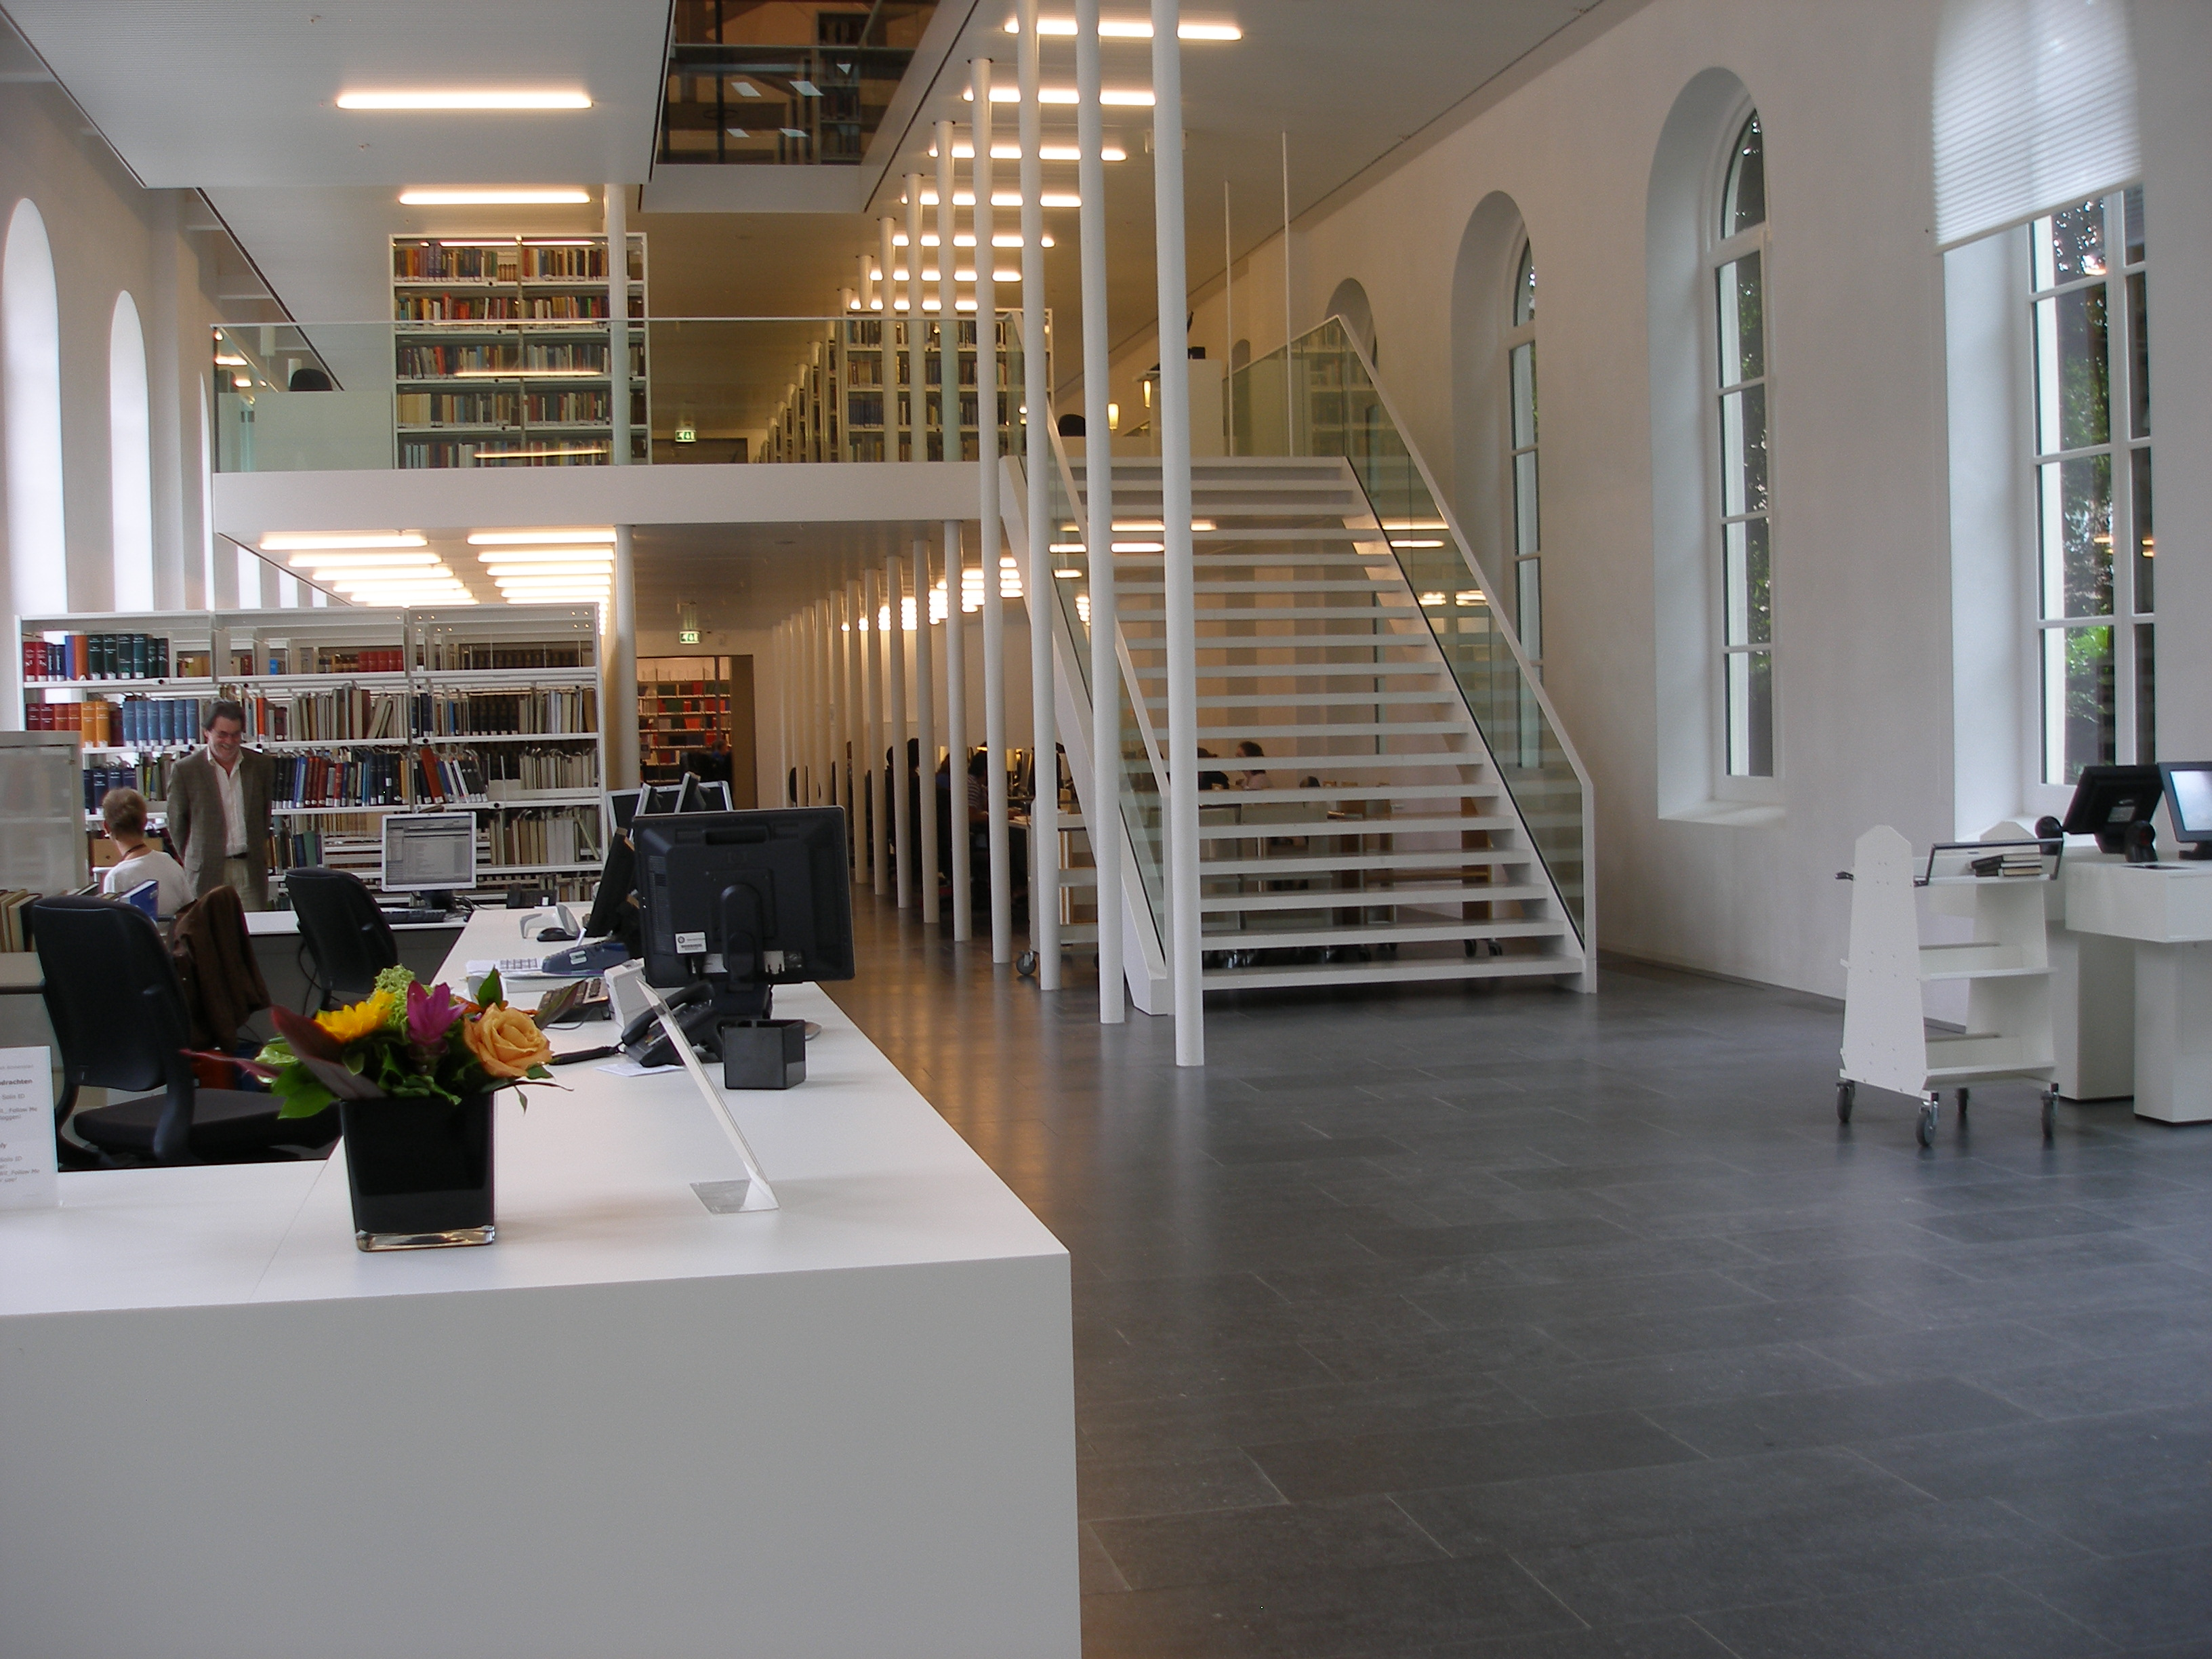
University libraries have lost their role in the discovery of scientific information.
They better focus on delivery.

Slide 3

In the next fifteen minutes I would like to share
…the reasons behind the decisions we made on discovery and delivery
&
…the steps we took to implement the changes
&
…the reactions of our users

Slide 4
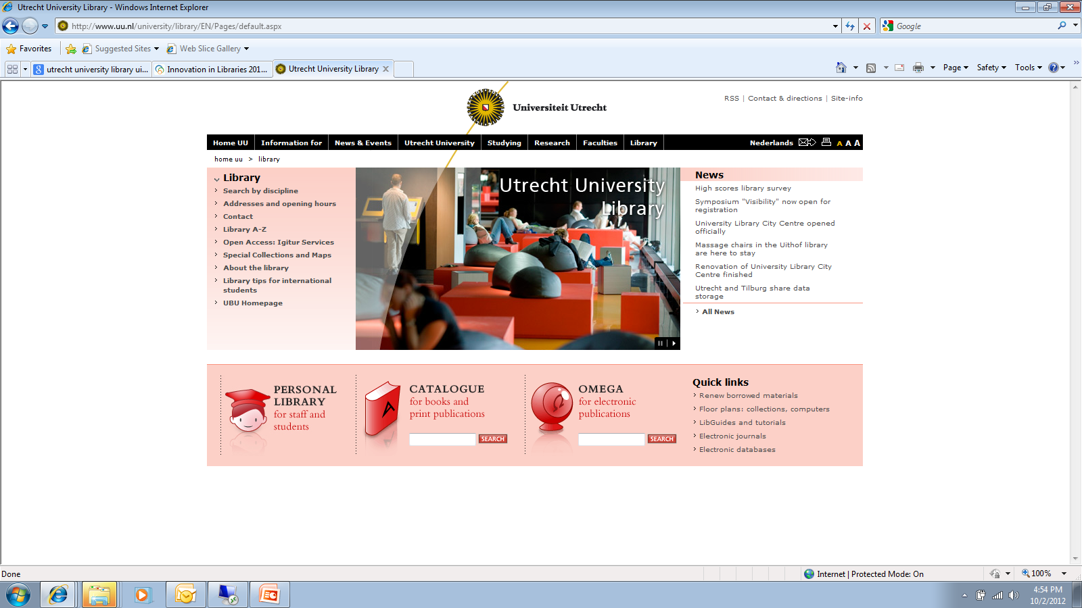
Discovery at Utrecht University until September 2013
Aleph WebOPAC plus Omega*
*Omega = custom made discovery system built in 2002 for discovery of scientific journal articles

Slide 5
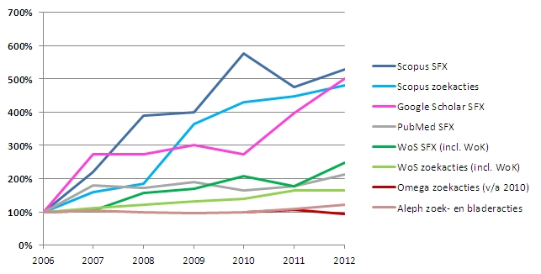
Trends search behaviour Utrecht University
relative increase / decrease in use

Slide 6
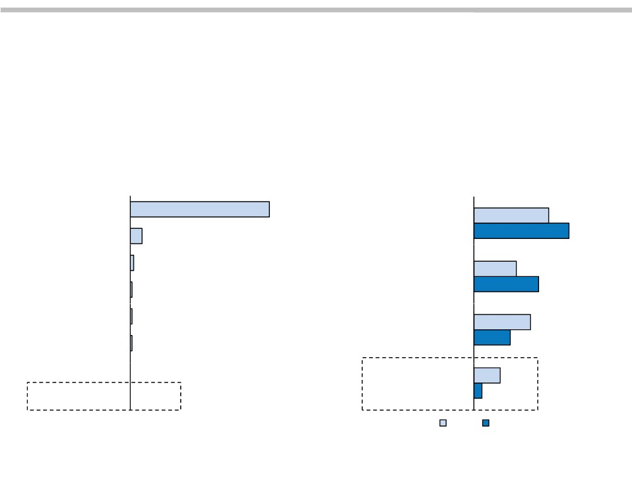
Patrons Switching Faster Than Libraries
Faculty and Students Already Looking Elsewhere for Search Help
Where Do Students Start a Search? Where Do Faculty Start Their Research?
n = 2,229 n = 3,025
Search Engine 83%
A specific electronic
research resource
37%
Wikipedia
7%
47%
Social Networking Site
E‐mail
2%
A general purpose
search engine
21%
1%
32%
E‐mail Subscription
Online Database
1%
Your online library
catalog
28%
1%
18%
Ask an Expert Site
Library Website
0%
13%
The library building
4%
0%
2003
2009
© 2011 The Advisory Board Company • www.educationadvisoryboard.com • 22852D
Source: “Faculty Study 2009: Key Strategic Insights for Libraries, Publishers,
and Societies” Ithaka S+R; “Perceptions of Libraries, 2010,” OCLC.

Slide 7

Conclusions in 2012
No need for a new library discovery tool
Phase out Omega on Sept. 1st 2013
Hold on to WebOPAC for the time being
Rethink the role of the library in providing access to scientific information

Slide 8
User survey
group interviews with students & scholars
What do they search for?
full-text articles (known item search)
subject-specific information
books
Where do they search?
Google Scholar
paid search engines
library catalogue

Slide 9


User survey
group interviews with students & scholars
One search engine to
find everything...
For me, that’s Google Scholar!

Slide 10
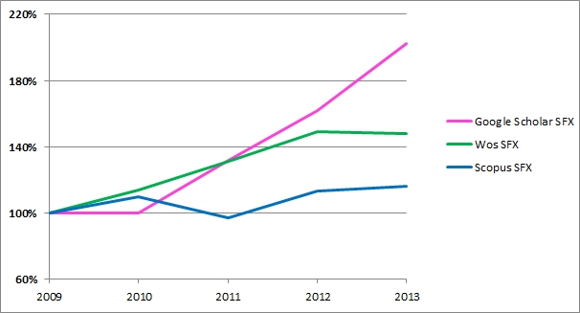
Trends search behaviour Utrecht University
relative increase / decrease in use

Slide 11
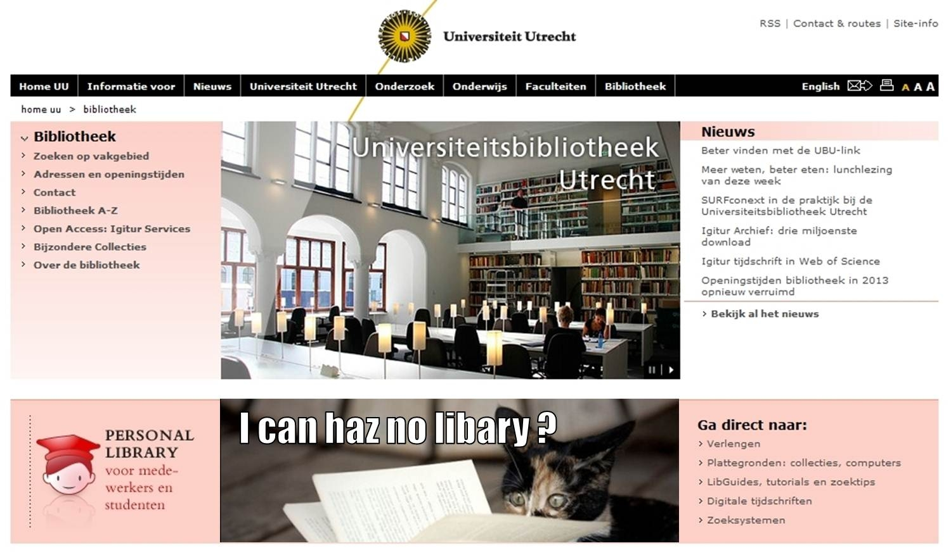
Library website

Slide 12
Communication
- Changes in library website
- Changes in instructions & support

Slide 13


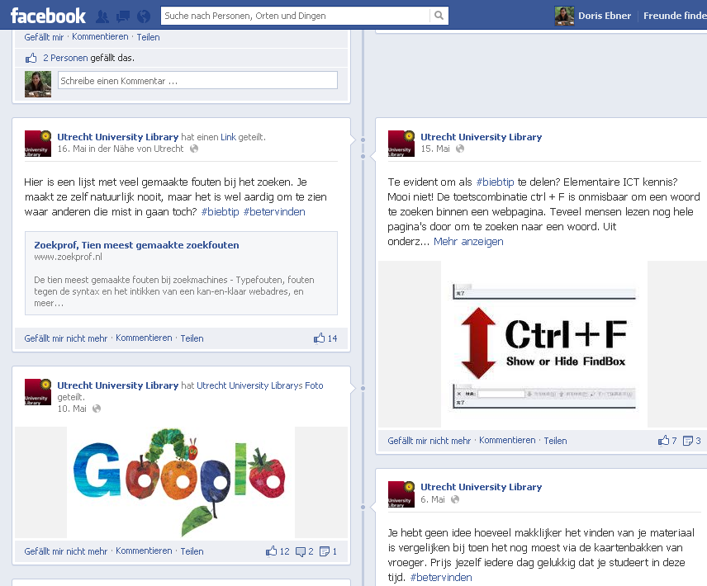
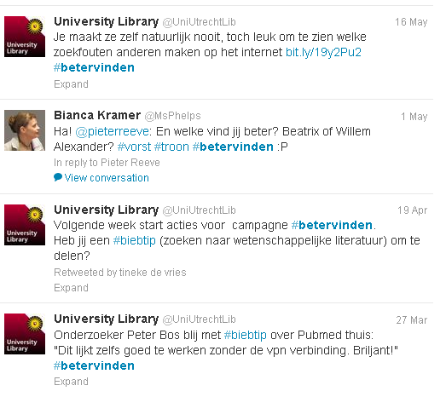
#biebtip #betervinden

Slide 14
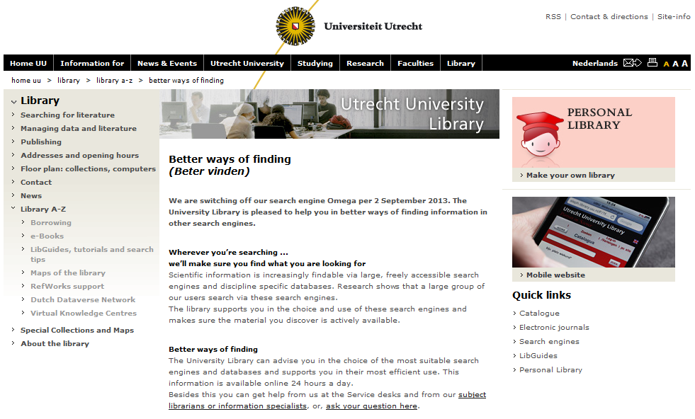

Slide 15
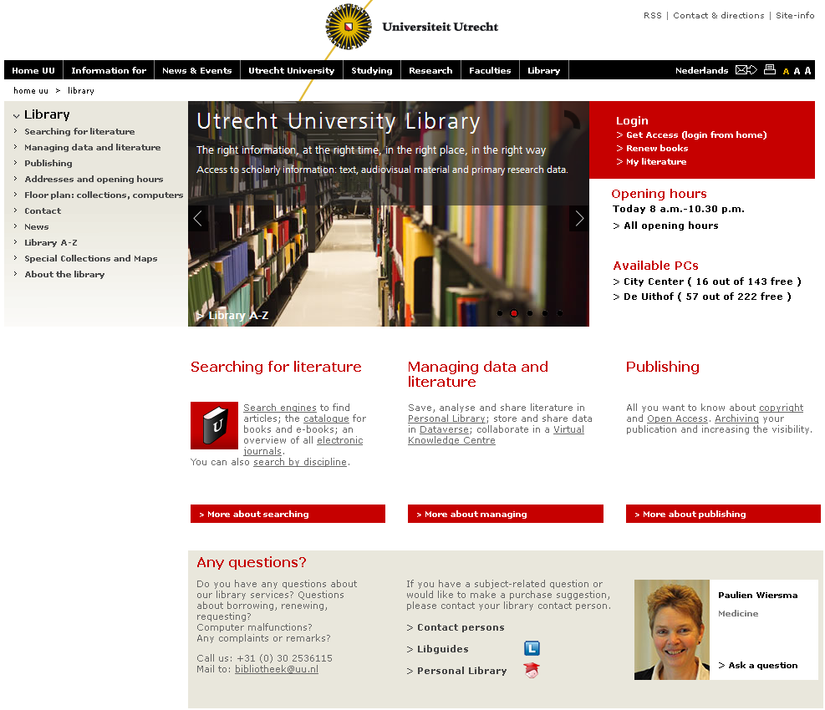

Slide 16
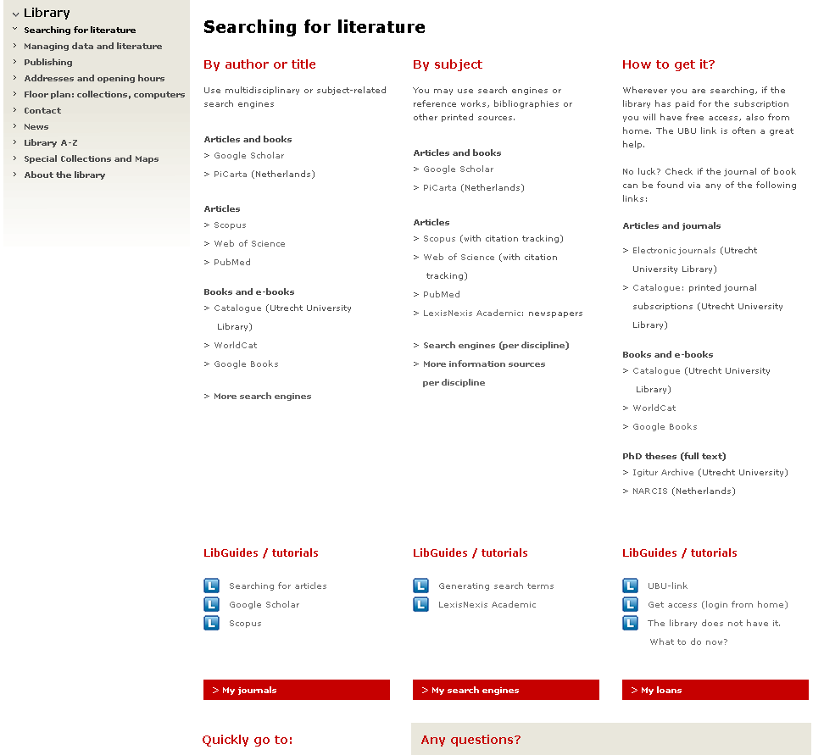

Slide 17
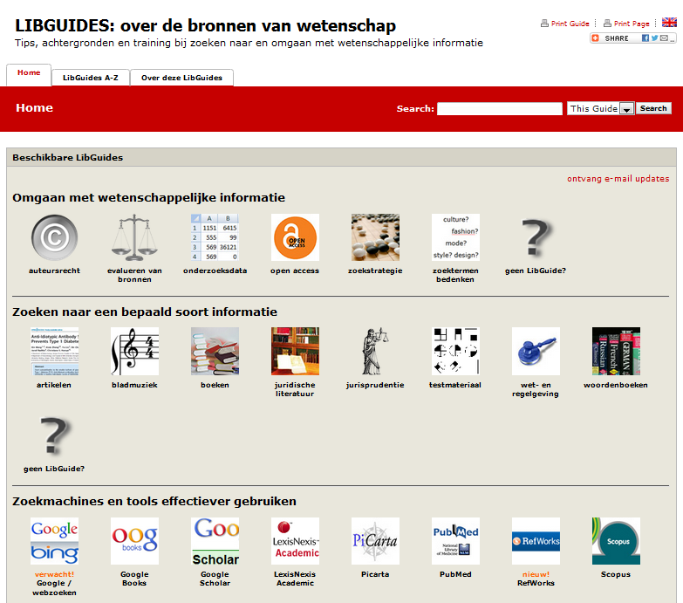

Slide 18
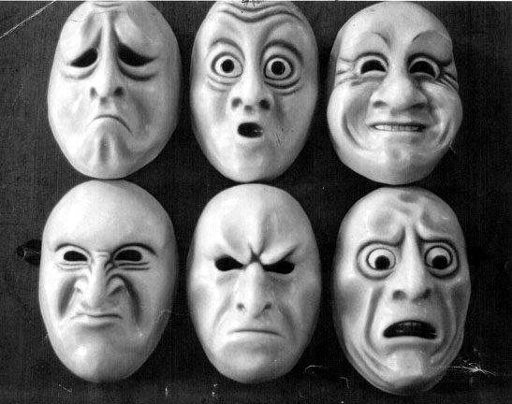

Slide 19
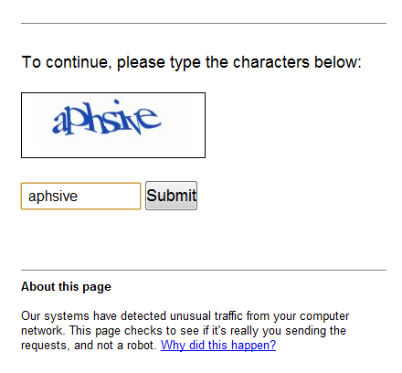
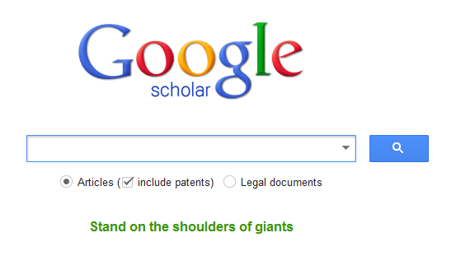

Slide 20
Wherever you’re searching,
we’ll make sure you get it!

Slide 21

Add holding information to discovery tools
Offer our SFX knowledge base to Google Scholar and Scopus
Open up our repository for harvesting
Supply easy authentication for off campus users

Slide 22
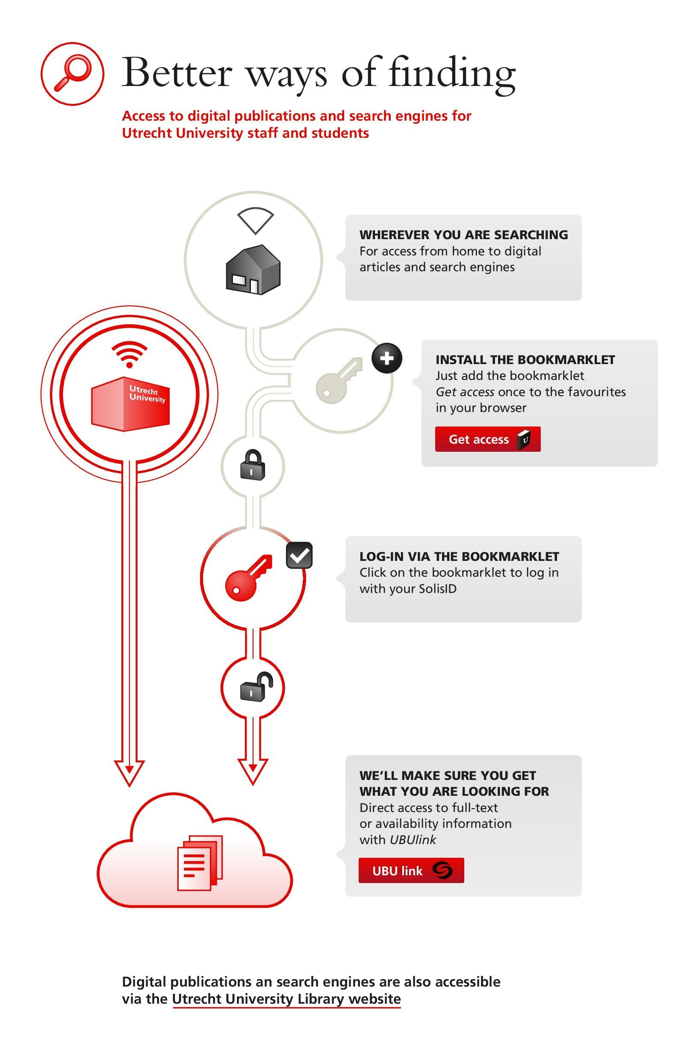
Bookmarklet (access from home):

Slide 23
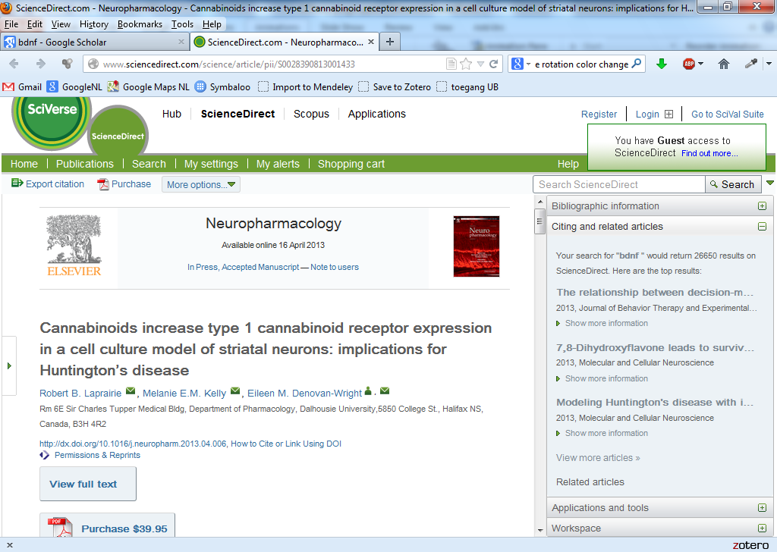
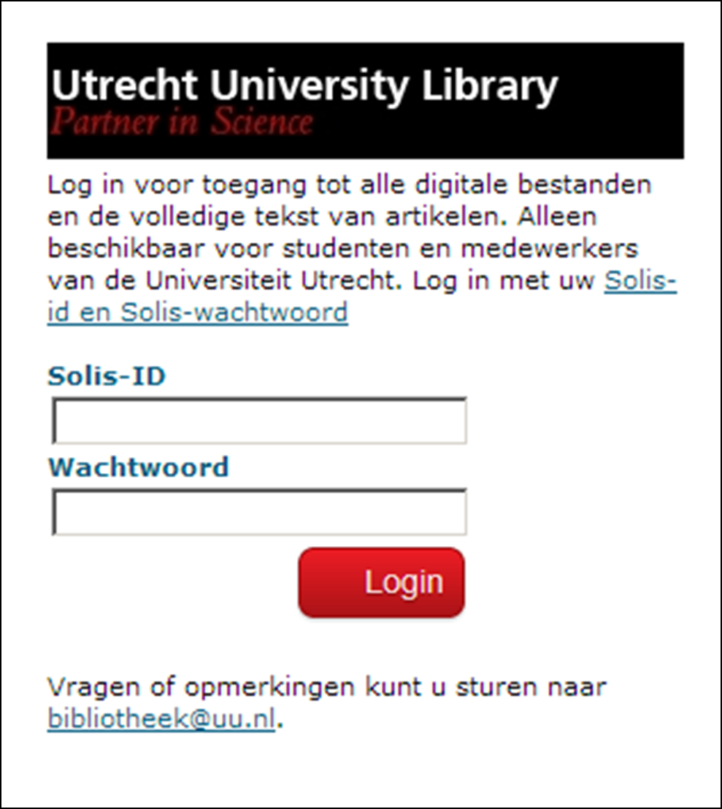

Bookmarklet (access from home):

Slide 24
Future steps
Keep improving delivery
Keep track of where our users are (trend watching, user surveys, statistics)
Cooperate with other libraries
Phase out our WebOPAC

Slide 25
Without your own discovery tool you might feel stark naked. However, we have to admit that others can do a better job on discovery.
Focus on delivery and rethink the way you can provide value for your users.

Slide 26

Thank you very much for your attention
This presentation was made with the help of my Utrecht colleagues.

